Slide 1
Ameliorating eutrophication in aquatic systems with plants
Jennifer Baez

Slide 2
Background
Eutrophication :
Hypoxic can create a dead zone where no organisms can survive. Caused by high levels of nutrients (Nitrogen, Phosphorus) and algae blooms.
Ecologically and economically sustainable approaches to ameliorating eutrophication in freshwater ecosystems

Slide 3
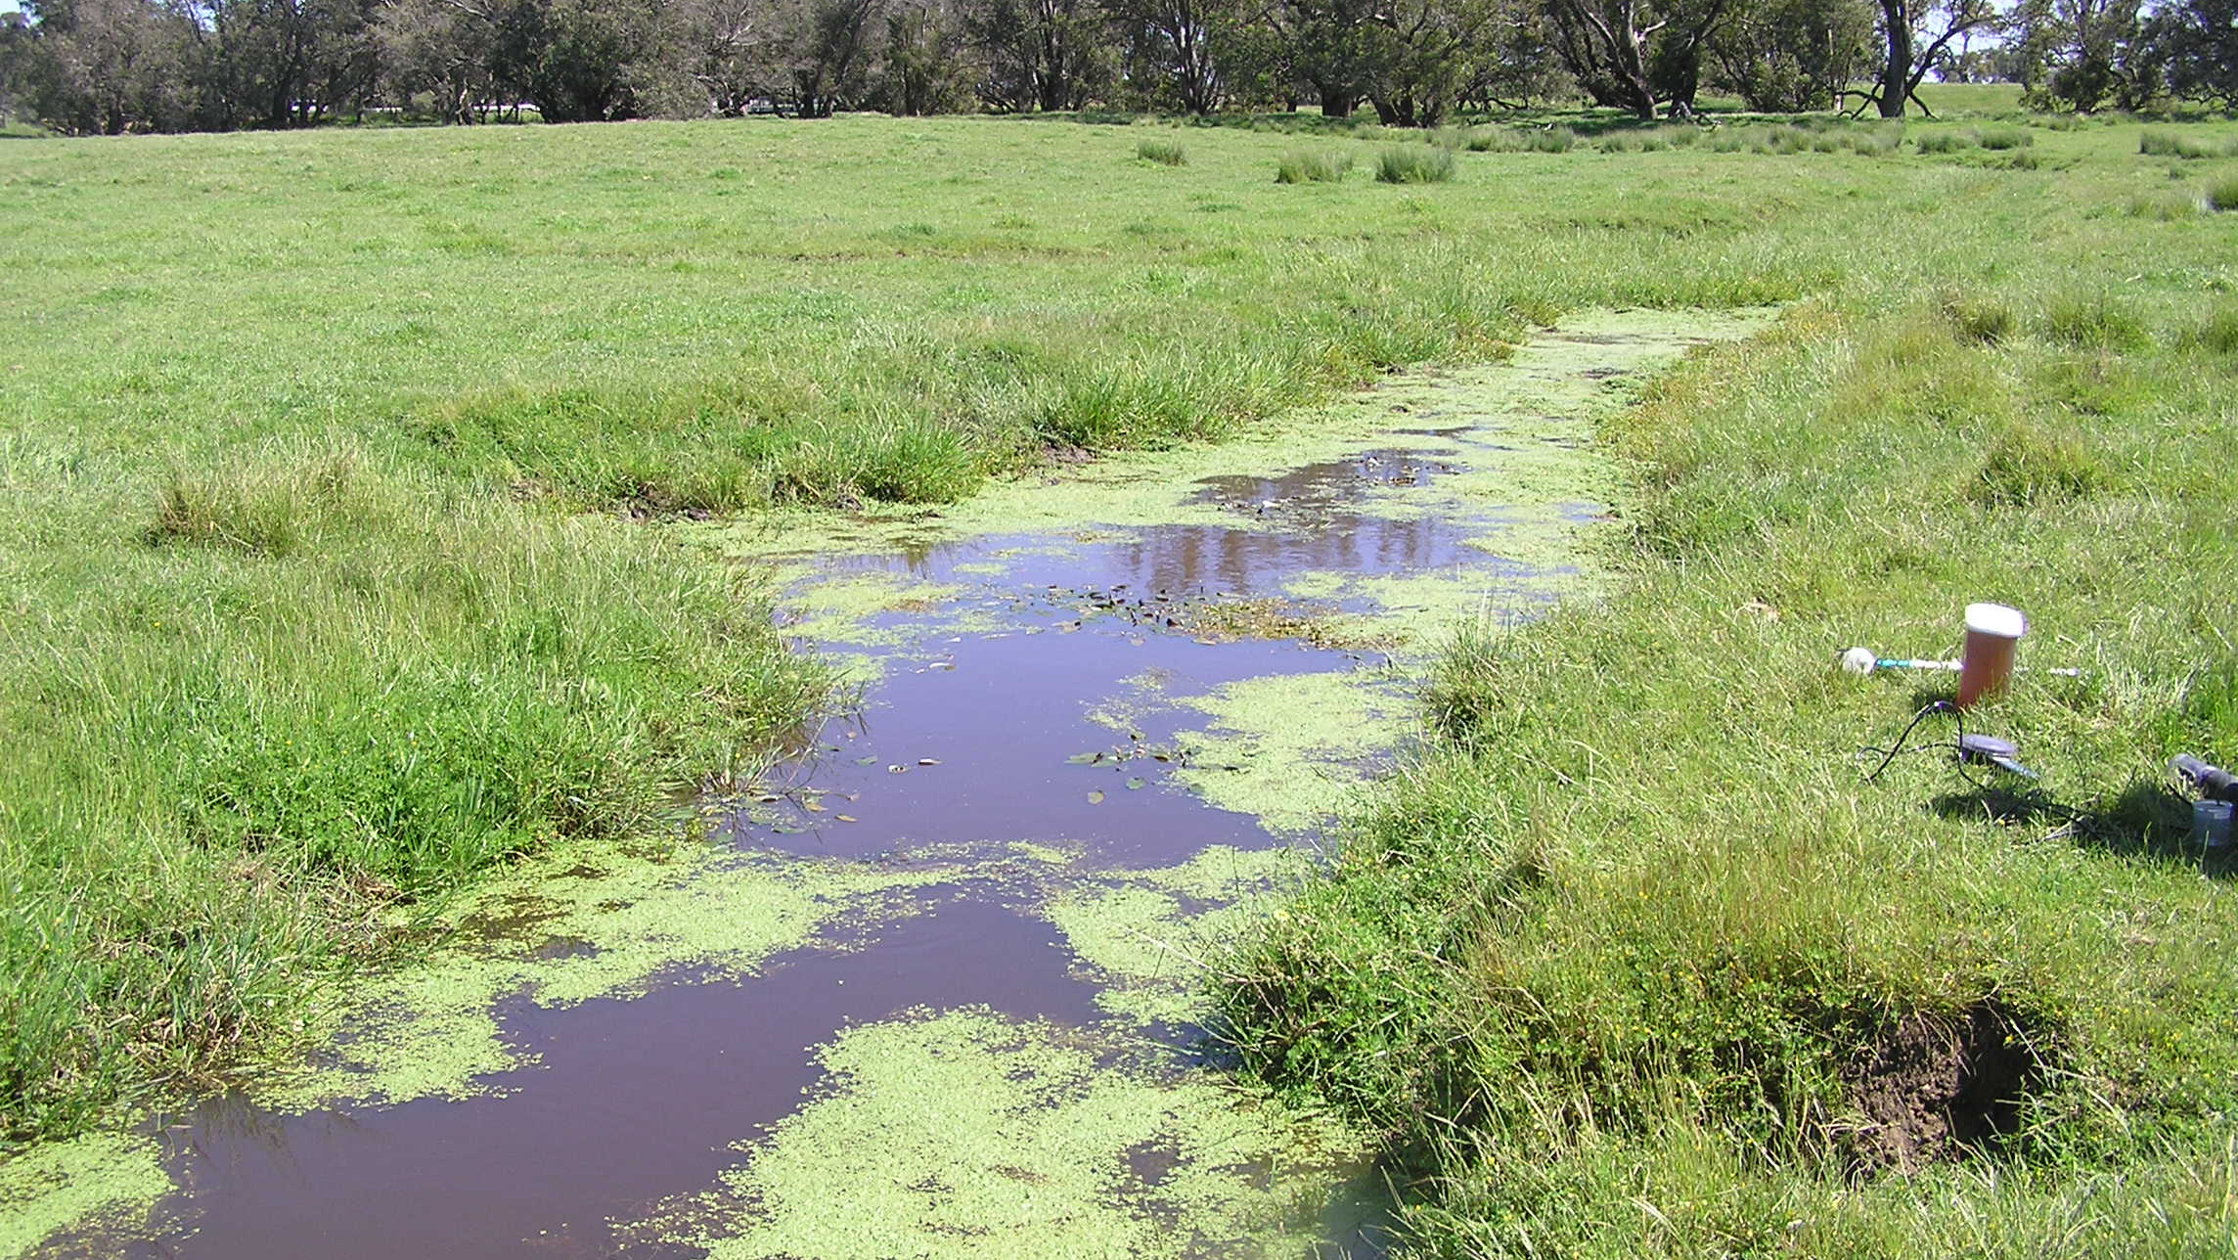

Slide 4
Compare growth of plant, fruit, and root (total biomass) As well as different variables (ph., conductivity, NH4, NH3,NO3) thought the experiment.
Methods:

Slide 5
Methods
Repeated measures ANOVA has at least 1 dependent variable that has more than one observation.
Interaction plots with time
plant | week1 | Week2,…10
Control | 82 | 95
Cattail | 76 | 88
Taro | 84 | 90

Slide 6
Methods
Step 1 Subset data
Step 3
P-values and Rsquare
Step 4 Shapiro test
Step 5 Test random effects
Step 2 ggplots

